Slide 1



Data Science and Machine Learning
Generative AI

Slide 2
Agenda
LLMs, Chatbots, Model vs Products and concepts
(Part of W1 + Somethign on APIs etc)
Model Architecture: S4-S62 of W1
Exercise on

Slide 3
Generative AI & Large Language Models

Slide 4
Generative AI
ChatBot
Who designed the street layout of Washington DC?
T
The street layout of
Washington D.C. was designed by Pierre Charles L'Enfant, a French-born American architect and civil engineer.

Slide 5
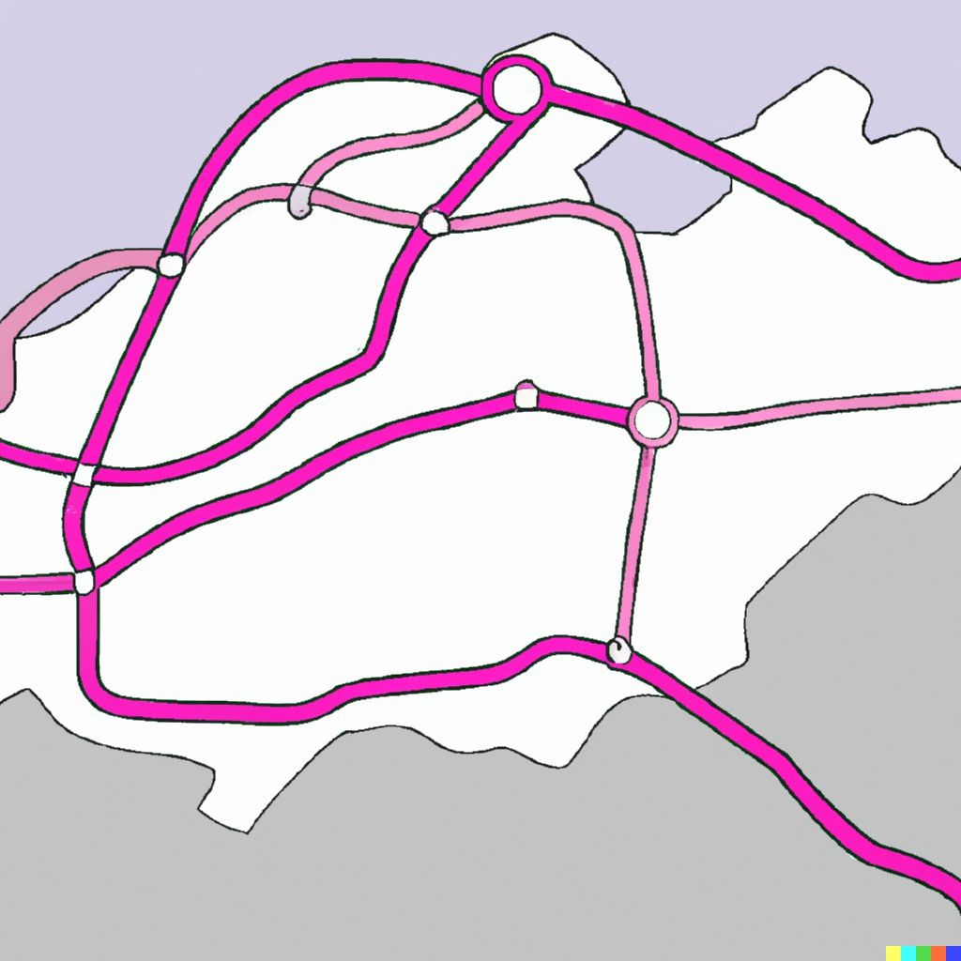
Generative AI
pAIntBox
What do you want to create?
An | imaginary | subway | map
in | a coastal | city.
Image dimensions:
by
(Max 2048)
Generate

Slide 6

Large Language Models
BLOOM
GPT
LLaMa
BERT
PaLM
FLAN-T5

Slide 7



Prompts and completions
Prompt
Model
Completion
Where is Ganymede located in the solar system?
Where is Ganymede located in the solar system?
LLM
Ganymede is a moon of Jupiter and is located in the solar system within Jupiter’s orbit.
Context window
For exemple, a few 1000 words.

Slide 8



Prompts and completions

Slide 9
Use cases & tasks

Slide 10
LLM chatbot
ChatBot
Who designed the street layout of Washington DC?
T

Slide 11
LLM chatbot
Who designed the street layout of Washington DC?
T
The street layout of
Washington D.C. was designed by Pierre Charles L'Enfant, a French-born American architect and civil engineer.
ChatBot

Slide 12
LLM use cases & tasks
Essay Writing
Summarization
Translation

Slide 13
LLM use cases & tasks
Essay Writing
Summarization
Translation
Information retrieval
Invoke APIs and actions
Action call
External Applications

Slide 14
The significance of scale: language understanding
BERT* 110M
BLOOM 176B
*Bert-base

Slide 15
How LLMs work - Transformers architecture

Slide 16
Generating text with RNNs
RNN

Slide 17
Generating text with RNNs
?
The milk is bad, my tea
tastes …
great.
RNN

Slide 18
Generating text with RNNs
?
The milk is bad, my
tea tastes …
great.
RNN

Slide 19
Generating text with RNNs
?
The milk is bad
, my tea tastes …
great.
RNN

Slide 20
Generating text with RNNs
?
The milk is bad
, my tea tastes great.
RNN

Slide 21

Generating text with RNNs
The milk is bad, my tea tastes great.
RNN

Slide 22

Understanding language can be challenging
I took my money to the bank.
River bank?

Slide 23
Understanding language can be challenging
The teacher’s book?
The teacher taught the student with the book.
The student’s book?

Slide 24
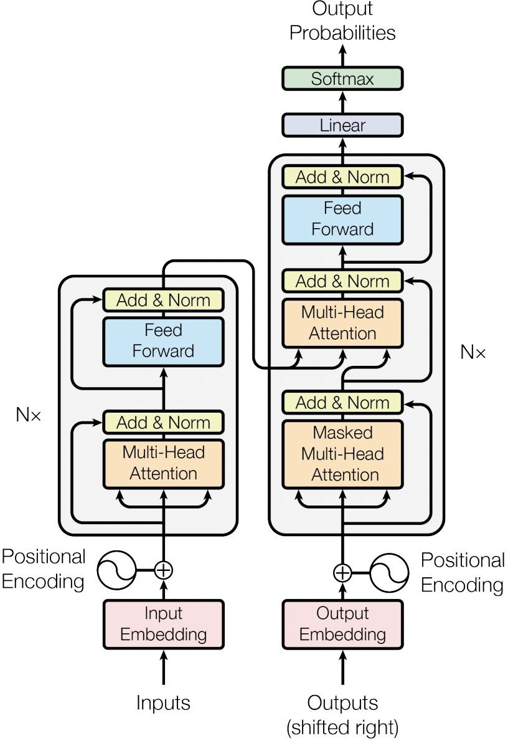

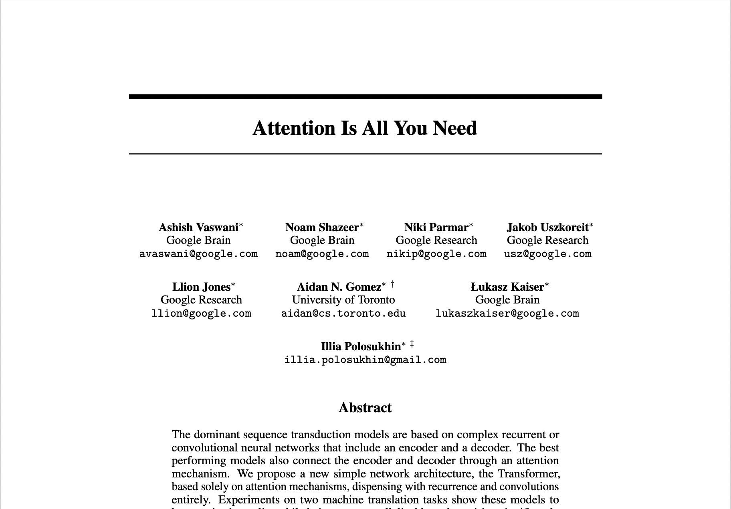
Transformers

Slide 25
Transformers
Scale efficiently
Parallel process
Attention to input meaning

Slide 26
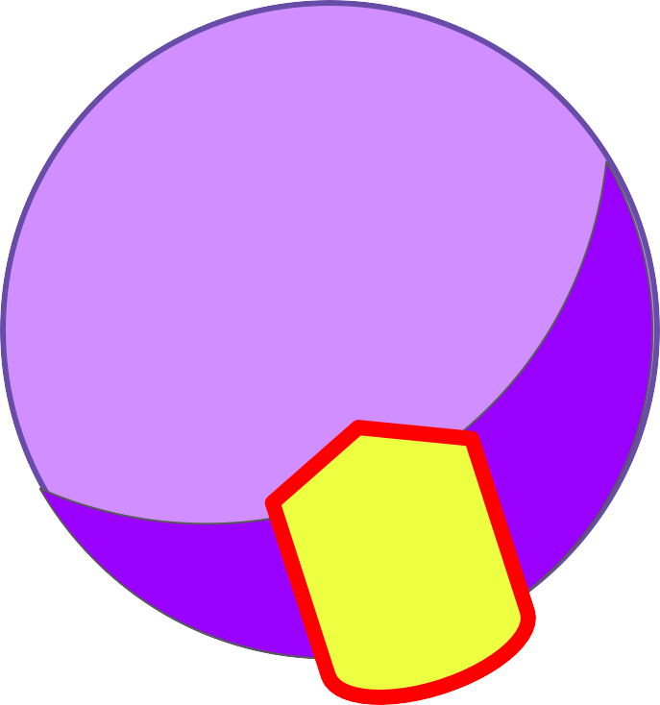

Transformers
RNN
LLM
L

Slide 27

Transformers
The teacher taught the student with the book.

Slide 28
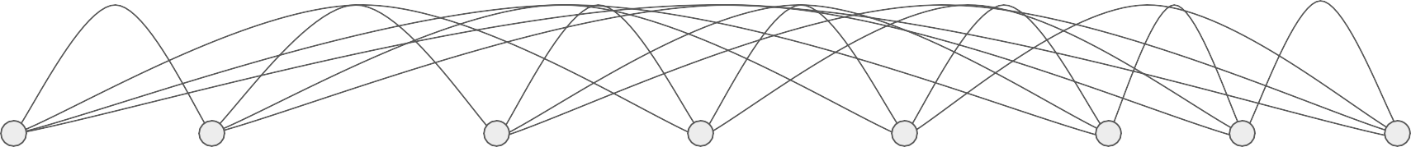
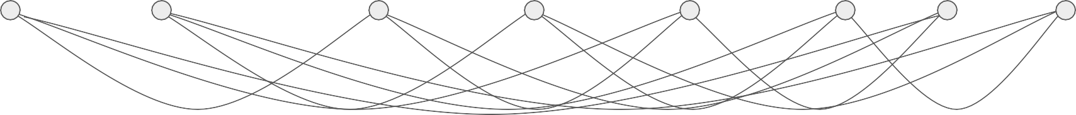
Transformers
The teacher taught the student with the book.

Slide 29
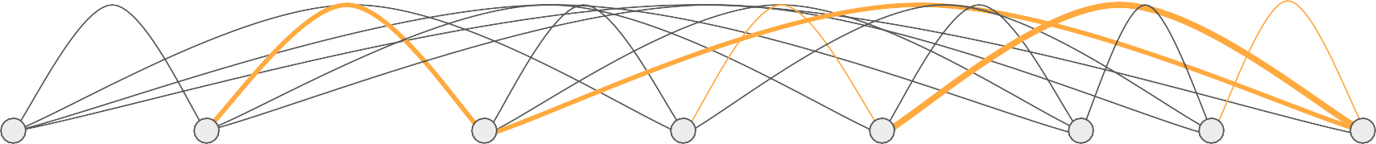
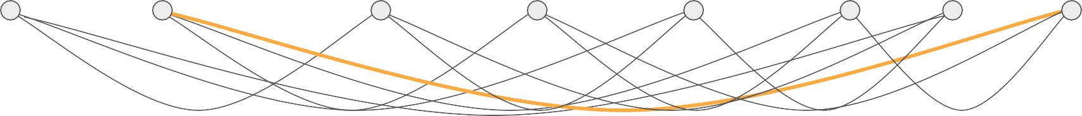
Transformers
The teacher taught the student with the book.

Slide 30
Self-attention
The teacher taught
the student
with
a book
.
The teacher taught the student with
a book
.

Slide 31
Self-attention
The teacher taught
the student
with
a book
.
The teacher taught the student with
a book
.

Slide 32
Transformers

Slide 33
Transformers
Output
Softmax output
Decoder
Encoder
Embedding
Embedding
Inputs

Slide 34
Transformers
Output
Softmax output
Decoder
Encoder
Embedding
Embedding
Inputs

Slide 35
Transformers
Output
Softmax output
Decoder
Encoder
Embedding
Embedding
Inputs

Slide 36


Transformers
Output
Softmax output
Decoder
Encoder
Embedding
Embedding
Inputs

Slide 37

Transformers
Decoder
Encoder
Embedding
Embedding
Inputs
Tokenizer
342 | 879 | 432 | 342
Token IDs
Input:
the teacher
taught the

Slide 38
Transformers
Decoder
Encoder
Embedding
Embedding
Inputs
Tokenizer
156 | 790 | 321 | 890 | 156
Token IDs
Input:
the teach er taught the

Slide 39


Transformers
Output
Softmax output
Decoder
Encoder
Embedding
Embedding
Embedding
Embedding
Inputs

Slide 40
Transformers
Output
Softmax output
Decoder
Encoder
ding Embedding Embedding Embedding
Inputs
X₁
X₂
X₃
X₄
e.g. 512
z
342 | 879 | 432 | 342
Embed
Embedding

Slide 41
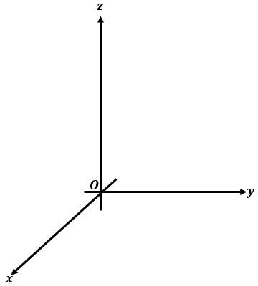


Transformers
fire
fox
student
book
internet
computer

Slide 42
Transformers
fire
fox
student
book
internet
computer

Slide 43
Transformers
fire
fox
student
book
internet
computer
Angle measures distance between words

Slide 44

Transformers
Output
X₁
X₂
S
o o
ftm
utp
X₃
ax ^{X4}ut
Position embeddings
+
X₁
X₂
X₃
X₄
e od
D
c
er
Token embeddin_{E}gs_{nco}
der
Positional Encoding
Positional Encoding
Embedding
Embedding
Inputs

Slide 45


Transformers
Output
Softmax output
Decoder
Encoder
Self-attention
Self-attention
Embedding
Embedding
Inputs

Slide 46


Transformers
Output
Softmax output
Decoder
EEnEncnccododeder er r
Multi-headed Self-attention
Multi-headed Self-attention
Embedding
Embedding
Inputs

Slide 47


Transformers
Output
Softmax output
Feed forward network
Feed forward network
Decoder
Encoder
Embedding
Embedding
Inputs

Slide 48
Transformers
Output
Softmax output
P1 P2 … … … … … … … … … … … … … … … …
Decoder
… … … … … … … … … …
…
Pn
Encoder
Embedding
Embedding
Inputs

Slide 49
Transformers
Output
Translation:
sequence-to-sequence task
Softmax output
J'aime l'apprentissage automatique
Decoder
Encoder
Embedding
Embedding
Inputs

Slide 50
Transformers
Output
Translation:
sequence-to-sequence task
Softmax output
J'aime l'apprentissage automatique
Decoder
Encoder
J’a
l'apprentissage
automatique
ime
2345
3425
3853
Embedding
Embedding
Inputs

Slide 51
Transformers
Output
Translation:
sequence-to-sequence task
Softmax output
J'aime l'apprentissage automatique
Decoder
Encoder
J’a
l'apprentissage
automatique
ime
2345
3425
3853
Embedding
Embedding
Inputs

Slide 52
Transformers
Output
Translation:
sequence-to-sequence task
Softmax output
J'aime l'apprentissage automatique
Decoder
Encoder
J’a
l'apprentissage
automatique
ime
2345
3425
3853
Embedding
Embedding
Inputs

Slide 53
Transformers
Output
Translation:
sequence-to-sequence task
Softmax output
J'aime l'apprentissage automatique
Decoder
Encoder
J’a
l'apprentissage
automatique
ime
2345
3425
3853
Embedding
Embedding
Inputs

Slide 54
Transformers
Output
297
Translation:
sequence-to-sequence task
Softmax output
J'aime l'apprentissage automatique
Decoder
Encoder
J’a
l'apprentissage
automatique
ime
2345
3425
3853
Embedding
Embedding
Inputs

Slide 55
Transformers
Output
297
450
901
389
Translation:
sequence-to-sequence task
Softmax output
J'aime l'apprentissage automatique
Decoder
Encoder
J’a
l'apprentissage
automatique
ime
2345
3425
3853
Embedding
Embedding
Inputs

Slide 56

Transformers
Output
297
450
901
389
Translation:
sequence-to-sequence task
Softmax output
I
love
machine
learning
J'aime l'apprentissage automatique
Decoder
I love machine learning
Encoder
J’a
l'apprentissage
automatique
ime
2345
3425
3853
Embedding
Embedding
Inputs

Slide 57
Transformers
Output
Softmax
Softmax output
output
Decoder
Encoder
Embedding
Embedding
Inputs

Slide 58
Transformers
Output
Softmax output
Encoder
Encodes inputs (“prompts”) with contextual understanding and produces one vector per input token.
Decoder
Accepts input tokens and generates new tokens.
Decoder
Encoder
Embedding
Embedding
Inputs

Slide 59
Transformers
Output
Output
Output
Encoder Only Models
Decoder Only Models
Decoder
Encoder
Decoder
Encoder Decoder
Encoder
Models
Input
Inputs
Input

Slide 60
The two pillars
Answer First
80/20
Start from the objective and identify relevant drivers
- Great to generate hypotheses that actually matter - Categorize and narrow down where DA/AI can add value
- Ballpark before you start
Prioritize ruthlessly and add complexity only when essential
- Focus on solving (parts of) issues that need to be solved - Spend your resources (usually time) wisely to generate the best solution

Slide 61
ANSWER FIRST

Slide 62
Answer First and Issue Trees
Start with a best-effort “solution” to what you want to achieve.
Break down the drivers of that solution, then break down the drivers of those drivers and so on
Make a rough estimation of the size and relative impact of each driver
e.g the profitability framework
Number clients
Items sold
Revenue
Orders / client
Price per item
Profitability
Fixed costs
Cost
Variable costs

Slide 63
Answer First and Issue Trees
Applied to data analytics
Focus on the leaves!
Profitability example
Oil carrier example
Not all nodes are going to be for DA/DS to handle
Relate to 80/20 and weight
Identify critical paths and define alternatives and assumptions (PM)
Ballpark to start!
Blocking analyses and impacts

Slide 64
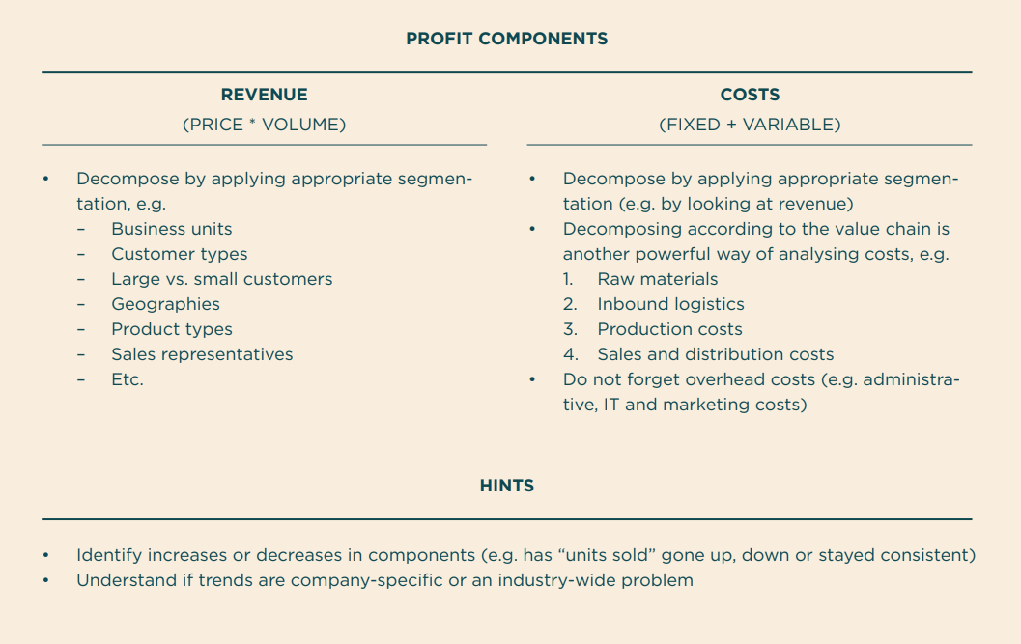
Profitability framework
The profitability framework helps you to systematically break down the profitability drivers.
Your goal is often to isolate significant historic developments (e.g. the cost of raw material has been surging), benchmark profitability drivers with competitors (e.g. our prices are lower than our peers) and evaluate opportunities (e.g. is it possible for us to increase profits by boosting sales of product A?).
The key to solving these cases is often to understand the underlying mechanics that produce the eventual anomalies in the numbers.
Think of different ways to segment costs and revenue.

Slide 65
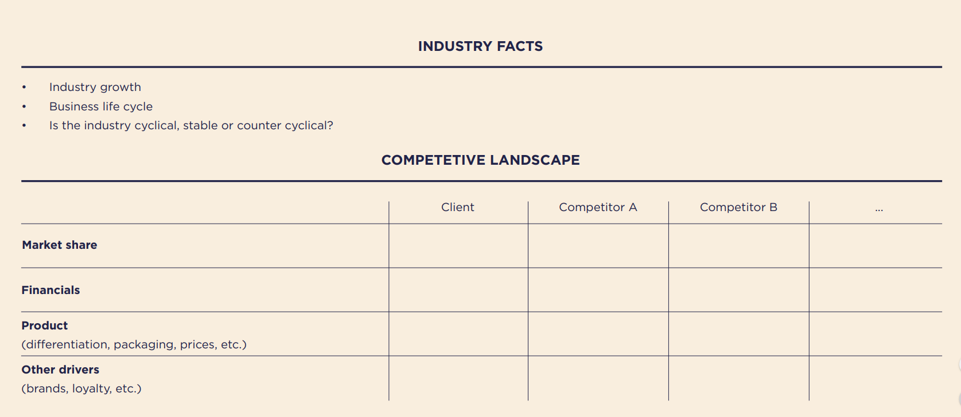
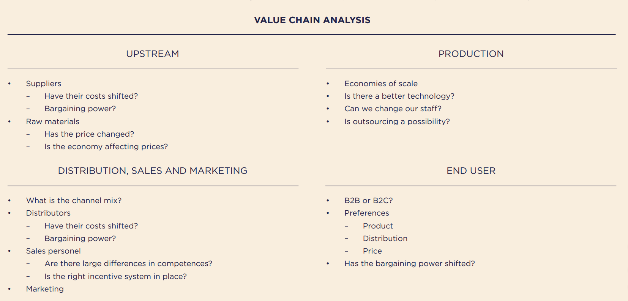
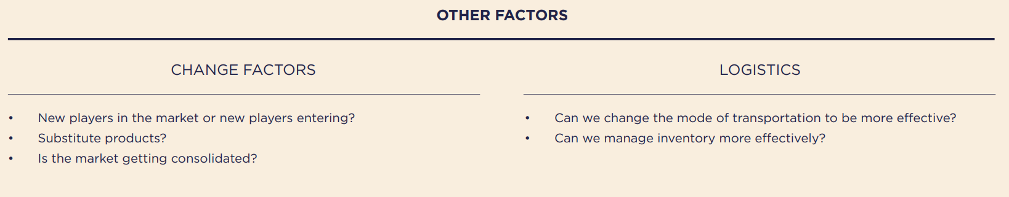
Industry Analysis framework
The industry analysis framework is designed to help you gather information on a company’s external environment. At first glance, it may appear overwhelming but many of the elements are likely already familiar to you.

Slide 66
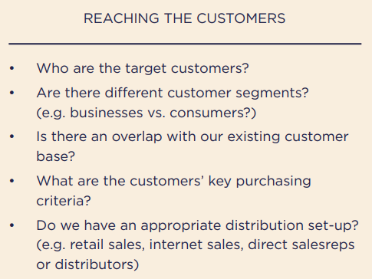
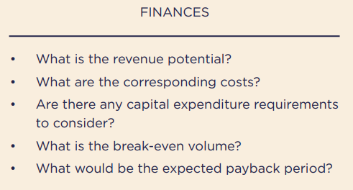
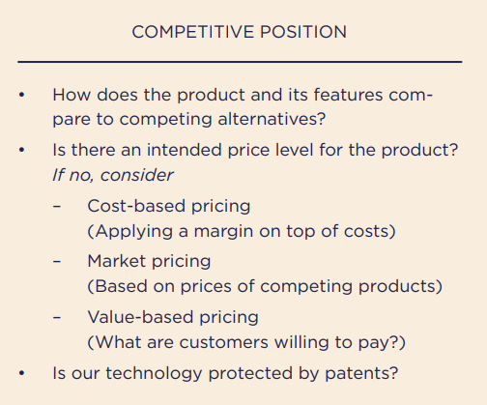
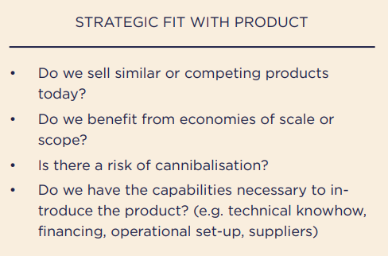
Product Strategy framework
This framework is similar to the industry analysis framework, with some important differences and additional issues. It is a bit more “management consulting” than the others, but nevertheless useful to at least get acquainted with the business

Slide 67
80-20

Slide 68
80-20 a.k.a. Pareto Law
“roughly 80% of consequences come from roughly 20% of the causes”
~20% of landowners own ~80% of the land in Italy
-Wilfredo Pareto
Caveats
Unlike most content in this course this is not actually an universal rule
The specific numbers 80/20 are an approximation to the power law effect: a majority of the output is due to a minority of the input
~20% of pea pods generate ~80% of seeds
-Wilfredo Pareto
Companies make ~80% of their revenue from ~20% of their customers
We wear ~20% of our clothes ~80% of the time
~80% of the world’s income goes to the top ~20% earners

Slide 69
How to exploit Pareto Law
Observation 1: Pareto’s law can be used recursively
Observation 2: The counter reciprocal of Pareto’s law must also hold
Select cautiously
Discard aggressively
Look at a decision tree and select the 20% of nodes where you think you can have the most impact. For the remaining 80% do your due diligence, but don’t focus on them
Even when working in your selected 20%, check if what you are about to sits in the “brings 80% of value” of the particular task - especially if it is complex/time consuming

Slide 70
Prioritization matrixes
The prioritization matrix is one of the simplest, yet one of the most powerful, business analysis tools. In the context of this presentation you can use it to select “your 20%”
Caveats
Watch out for dependencies. Your 20% task may be dependent on a non-20% task
Your “ease of implementation” may not consider all variables (integration, maintenance, change management...)
Your “impact” may not consider all variables (product already sold, unknown business process…)
When in doubt… ask
Impact
Your 20%
Ease of implementation

Slide 71
Some cases to train your A1 and 80/20 muscles
Bite sized sample for guidance: How big is the market for home delivery of newspapers in Lisbon?
Key: Number of households in Lisbon, Share of households that subscribe to a newspaper (segmented on interests, education, age, income or other), Number of subscriptions per household (segmented on interests, education, age, income or other), Frequency of delivery (magazine, journal, daily). Delivered newspapers in Lisbon per day multiplied by days in a year to detect volume, multiplied again by cost per delivery to find market size.
Not bite-sized case for practice:
After years of engineering work, you finally have the world’s first commercially viable spacecraft. It cost you EUR 50 million to build. From its launching pad outside Paris, it can take a load of up to 12 passengers into space, orbit earth and then return safely eight hours later. There are no safety concerns whatsoever. The spacecraft can do three trips per week and the operational costs related to each trip (salaries, fuel, maintenance) are EUR 75,000. There are no competing products, and the design is effectively protected by patent rights for the next 25 years. It will take you three years to build an additional spacecraft. How would you take the product to the market in the next three years, before you could have another spacecraft?

